Slide 1
CS2S562
Secure Software Development
Formatted I/O

Slide 2
What – No CERT.org Table?
No, because:
  Formatted I/O is too complex an area
  There is no single remediation solution for individual problems but a set of ‘Best Practice’ rules (use these in your coursework 1)

Slide 3

  Starter
  - Introduction to formatted I/O in C and C++
  Main Courses
  - Contrast to unformatted I/O
  - The problem with formatted I/O
  Afters
  - Dealing with GUI input

Slide 4
Formatted I/O
What is it?
  Uses functions to manipulate I/O streams:
  printf (print formatted)
  outputs to the standard output stream (stdout, the console)
  fprintf (file print formatted)
  output goes to a file handle (FILE*)
  sprintf (string print formatted)
  output goes to a char[ ] buffer
  the scan functions do the opposite, i.e. input
C <stdio.h> | C++ <iostream> C++ GUI
printf(), sprintf(), fprintf() | cin | e.g. Label
scanf(), sscanf(), fscanf() | cout | e.g. TextBox
strderr | cerr | N/A

Slide 5
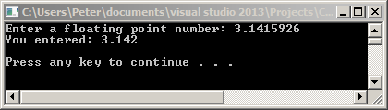
Formatted I/O
C Example:
  Print a float with only 3 digits after the decimal point:
#include "stdafx.h" // for Microsoft....
#include <iostream> // for system()
void main() {
float a;
// Formatted read-in as a float
printf("Enter a floating point number: ");
scanf_s("%f", &a);
// Formatted output of float, restricted to 3 decimals
printf("You entered: %.3f", a);
// Two new lines and then 'Press any key to continue'
printf("\n\n");
system("pause");
}

Slide 6
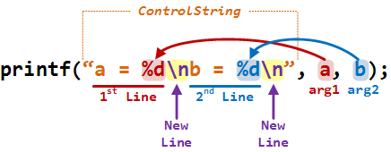
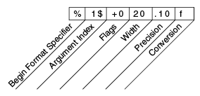
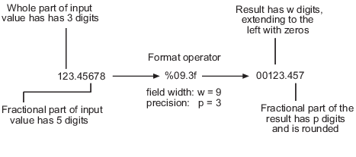
Formatted I/O
C print and scan Formatting
  weird in the beginning but VERY concise

Slide 7
Formatted I/O
C++ Example:
  print a float with only 3 digits after the decimal point:
#include "stdafx.h" // for Microsoft....
#include <iostream> // for system()
#include <iomanip> // for setprecision()
using namespace std;
void main() {
float a;
// Formatted read-in as a float
cout<<"Enter a floating point number: ";
cin >> a; // automated conversion to correct type (here: float)
// Formatted output of float, restricted to 3 decimals
cout << "You entered: " << fixed << setprecision(3) << a;
printf("\n\n");
system("pause");
}

Slide 8
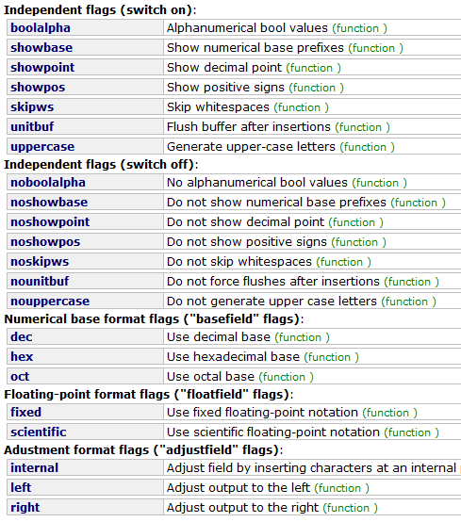
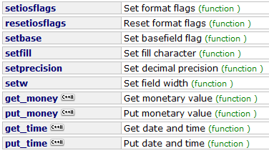
Formatted I/O
C++ cin and cout Formatting:
  formatting using parametric
  manipulator functions
  and flag functions

Slide 9
Formatted I/O
scan & print vs. cin & cout
scan & print (old practice) | cin & cout (best practice)
not typesafe (programmer can accidentally combine wrong % formatter with an unsuitable type) | typesafe (automatically deducts correct type)
fast | slower "by 2 orders of magnitude" (not a problem for console I/O but for file I/O)
single 1 page 'user manual' | many functions setting flags, complex interaction of these flags, code verbose
stateless ("fresh" at every use) | have state: previous use of member functions persist
work in C and C++ | C++ only
new _s functions safer (include bounds checking, buffer overflow and string truncation protection)
  THEREFORE: C versions still widely used

Slide 10
  Starter
  - Introduction to formatted I/O in C and C++
  Main Courses
  - Contrast to unformatted I/O
  - The problem with formatted I/O
  Afters
  - Dealing with GUI input

Slide 11
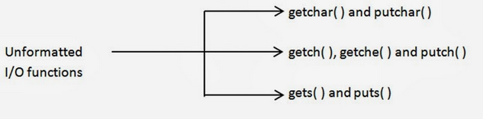
In Contrast To: Unformatted I/O
Operators (C++ only, working on all data types)
    just '<<' or '>>' (no parametric of flag functions set)
C Functions/Methods (working on char / char[ ] only)
  unformatted I/O is generally more SAFE
  because formatting is done afterwards (next slide)
(Best Practice)

Slide 12
Dealing with Unformatted I/O
(Best Practice)
Unformatted input
Trusted Component
Canonicalise
Output sanitisation
Output
Normalise
Core of Trusted Component
Sanitise
Validate

Slide 13
Canonicalisation
Unformatted input
Trusted Component
Canonicalise
Output sanitisation
Output
Normalise
Core of Trusted Component
Sanitise
Validate
Meaning
  lossless reduction of the input
  bringing it into equivalent simplest know form (e.g. 007.50→7.5)
Example: pathname of file
  '.' in pathname indicates current directory
  you want to prevent access to "\myStuff\secretDir"
  so you check if(path=="\myStuff\secretDir"){
  but if an attacker could input "\myStuff\.\secretDir" as the path the above check fails
  can be prevented with: PathCanonicalize(path,input);
Notes:
This might be things like stripping out the whitespace and ensuring that only the important data is being used.
In the example, you can just call canonicalize to standardize the filepath, so you know what you are getting.

Slide 14
Normalisation
Unformatted input
Trusted Component
Canonicalise
Output sanitisation
Output
Normalise
Core of Trusted Component
Sanitise
Meaning
  lossy reduction of the input
  bringing it into equivalent simplest and anticipated known form by stripping away not required parts of the input
Example: extraction of file name from path
  the input may be "C:\Users\Peter\Desktop\Hello.pdf"
  If the Trusted Component needs only the file name, then
  strip away "C:\Users\Peter\Desktop\" and pass only "Hello.pdf" on
Validate

Slide 15
Sanitisation
Unformatted input
Trusted Component
Canonicalise
Output sanitisation
Output
Normalise
Core of Trusted Component
Sanitise
Meaning
  input: checking that data conforms to the requirements of the subsystem
Example: Input check on system() command:
  the Trusted System has a code line system(buffer);
  system() issues a operating system command
  system(" format C:") wipes the hard drive
  sanitisation by case insensitive _safe compare:
  if ( strcasecmp_s(buffer,"format c:")==0 ) { // oops! }
  else { system( buff ); }
Validate
Notes:
Basically sanitization means make safe. We know it’s a string, we know it’s been normalized, but it still might be a dangerous string.

Slide 16
Validation
Unformatted input
Trusted Component
Canonicalise
Output sanitisation
Output
Normalise
Core of Trusted Component
Sanitise
Meaning
  ensuring that data fall within the expected domain of valid input
  (related to sanitisation / no clear boundary)
Example: check on uint16_t overflow
Validate
uint16_t safeAdd16(uint16_t ui16_a, uint16_t ui16_b) {
uint16_t ui16_sum;
if (UINT16_MAX – ui16_a < ui16_b) {
// error message, then return 0
} else {
ui_sum = ui_a + ui_b;
return ui16_sum;
}
}
Notes:
Lastly, any associated validation, a good example of this might be a postcode – sanitization makes sur you have the format of a postcode, validation makes sure it is genuinely a postcode. CF80 3RR is sanitized, but not valid (probably, I didn’t check if it exists!)

Slide 17
Core
Unformatted input
Trusted Component
Canonicalise
Output sanitisation
Output
Normalise
Core of Trusted Component
Sanitise
Validate
Input data now safe to use
  core can do computations without being harmed (safe) or causing harm (secure)
You are now in the circle of trust

Slide 18
Output
Sanitisation
Unformatted input
Trusted Component
Canonicalise
Output sanitisation
Output
Normalise
Core of Trusted Component
Sanitise
Meaning
  output: prohibit leakage of sensitive data to next Trusted Component
Example: Credit card info:
  the Trusted System Core has decrypted credit card data from and encrypted file, and done a transaction.
  now has to inform the next Trusted Component (e.g. a transaction logger) which credit card was used in the transaction.
  solution: the credit card number has to be encrypted again or the credit card index in the encrypted file is passed on.
Validate
Notes:
Output is so much shorter because we can safely assume that any input has gone through the previous steps, so we know it is canonicalized, we know it is normalized, sanitized and validated, so we just need to sanitize it for the person we are displaying it to.

Slide 19
  Starter
  - Introduction to formatted I/O in C and C++
  Main Courses
  - Contrast to unformatted I/O
  - The problem with formatted I/O
  Afters
  - Dealing with GUI input

Slide 20

So, What's The Problem with Formatted Input?
Input
  predominantly: buffer overflow attacks
  … but these can be handled (see lecture 1)
  however, formatted input functions still bypass
  canonicalisation, normalisation, sanitisation & validation
Output
  allows attacker to inspect the stack
  knowledge of stack (e.g. where function return addresses are stored) allows then manipulation of code (e.g. through buffer overflow attack)
  why is that?
  we need to understand "variadic functions" first

Slide 21
Variadic Functions
A Normal Function Call (as we know it):
  actual and formal parameter lists must match in
      amount
      type
      order
    of parameters
#include "stdafx.h" // for Microsoft....
#include <iostream> // for system()
#include <stdint.h> // for uintXX_t
using namespace std;
void addThem(uint16_t ui16_a, uint16_t ui16_b)
{
uint32_t ui16_sum = ui16_a + ui16_b;
cout << "Result is: " << ui16_sum << endl;
}
void main() {
uint16_t ui16_x = 5, ui16_y = 10;
addThem(ui16_x, ui16_y);
printf("\n\n");
system("pause");
}

Slide 22

Variadic Functions
#include "stdafx.h" // for Microsoft....
#include <iostream> // for system()
#include <stdint.h> // for uintXX_t
#include <cstdarg> // for va_start(), va_arg()
using namespace std;
void addThem(uint16_t a, ...)
{
uint32_t sum = 0, i=a;
va_list marker;
va_start(marker, a);
while (i != 0) {
sum = sum + i;
cout << "Sum is: " << sum << " and i is "<<i<< endl;
i = va_arg(marker, int);
}
va_end(marker);
cout << "Result is: " << sum << endl;
}
void main() {
uint16_t a = 5, b = 10, d=20;
addThem(a, b, d);
printf("\n\n");
system("pause");
}
A Variadic
Function:
  actual parameter list can have any number of parameters, indicated by so called ellipsis: …
Notes:
We use variadic functions to perform a task where we know there could be lots of arguments and we know how to deal with them, but we don’t know how many there will be, so we just define an open ended argument list.

Slide 23
Variadic Functions
C print and scan Functions are Variadic
  e.g.
  % is the killer if an attacker can insert format strings:
    %(whatever) with a parameter is fine but…
    %(whatever) without parameter prints from the stack
    Therefore: never allow the user to enter format strings (a CERT rule → next slide)
#include "stdafx.h" // for Microsoft....
#include <iostream> // for system()
#include <stdint.h> // for int16_t, etc
void main() {
int16_t anInt = 10;
float aFloat = 3.141f;
char aCharArr[] = "Hello";
printf("The INT: %d, the FLOAT: %f, the CHAR[]: %s", anInt, aFloat, aCharArr);
printf("\n\n");
system("pause");
}
C <stdio.h>
printf(), sprintf(), fprintf()
scanf(), sscanf(), fscanf()
3 % formatters
3 parameters

Slide 24
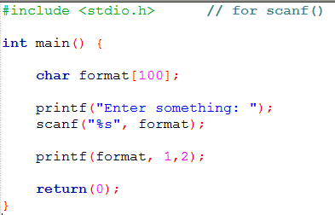
Exploiting Format Strings
Simple Example
  Made in CodeBlocks using GCC compiler
  This won't work in Visual Studio
  VS enforces use of _s functions which
  safeguard against the problem
  Analysis of stack content
  (e.g. find position of current function's
  return address) can then be
  used to produce an exploit
  (e.g. change return address to point
  to malicious code)
correct output
stack content
Notes:
A demonstration has been built and ca be given if we have time in the lecture, otherwise I can do the demonstration in the lab.

Slide 25
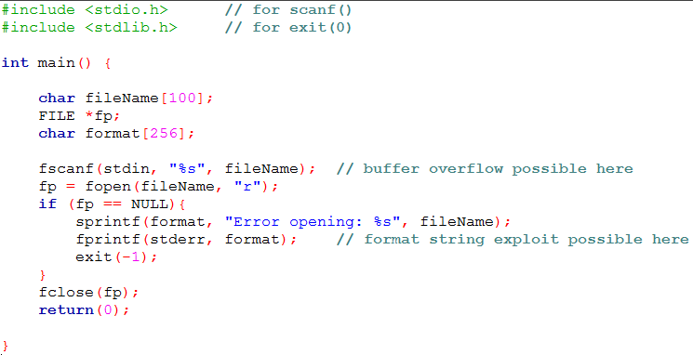
Exploiting Format Strings
File I/O Example in C
  Again CodeBlocks using GCC (as VS won’t allow this)
  2 attack vectors here: buffer overflow and format string exploit by reading in badly formed 'fileName' string from keyboard

Slide 26
Exploiting Format Strings
The same File I/O Example in C++
  Visual Studio → much safer by using cin & string class
#include "stdafx.h" // for Microsoft....
#include <iostream> // for cin, cout, cerr
#include <fstream> // for file ifstream I/O
#include <string> // otherwise cin of string won't work
using namespace std;
void main() {
string fileName;
ifstream ifs;
cin >> fileName; // cin of string: no buffer overflow possible
ifs.open(fileName.c_str());
if (ifs.fail()) {
cerr << "Error opening " << fileName << endl; // no formatter - that
// could be awkward
exit(-1);
}
ifs.close();
}

Slide 27

Exploiting Format Strings
Formatted Output exploits
  text input from keyboard
  text input from file. Example:
  Internationalisation
  i.e. text files with translations for menus, labels, dialog boxes, etc in many languages
  text files can easily be changed (e.g. Notepad)
  changed text containing format strings is then used in program

Slide 28
  Starter
  - Introduction to formatted I/O in C and C++
  Main Courses
  - Contrast to unformatted I/O
  - The problem with formatted I/O
  Afters
  - Dealing with GUI input

Slide 29
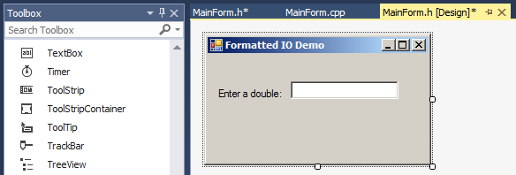
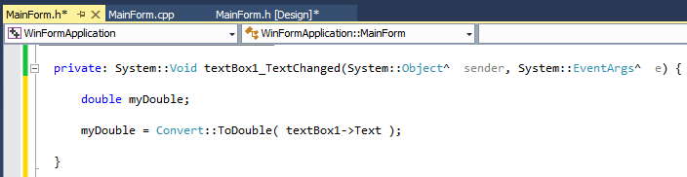
GUI User IO
Input via TextBox* Control
  TextBox 'Text' property is a <string> object (not a char[ ])
  may have to be converted to an int, float, double, etc.
* other text input controls are 'RichTextBox' and various Dialog inputs (e.g. "File Save As")

Slide 30
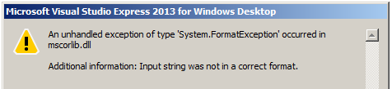
GUI User IO
Input via TextBox* Control
  When you enter a floating point type (e.g. 1.234) all is fine
  When you attempt to enter "hello" you get this at the first letter 'h':
  So, how can we "handle" the "exception"?
  Answer: by using 'try-catch'
* other text input controls are 'RichTextBox' and various Dialog inputs (e.g. "File Save As")

Slide 31
Brief Excursion: 'try – catch'
Many C++ Methods can "throw" exceptions
  they can be "handled" by the programmer like this:
  Explanation:
    The program 'tries' to do the code in the try { } block. If that code is OK then it skips over the code in the catch {} block and continues as normal.
    If the code in the try { } block "throws" an exception then it winds back ('undo') back to the beginning of the try { } block and then executes the code in the catch { } block.
The caret '^' (pronounced 'hat') is a Microsoft extension to standard C++ for the CLI (i.e. the .NET Common Language Infrastructure). It is the managed equivalent of a *(pointer) and in CLI terminology - called a 'handle' to a 'reference type'.
try
{
//line or lines of code that can throw an exception
}
catch (Name_of_Exception_here^)
{
// line or lines of code that 'handle' the problem
}

Slide 32
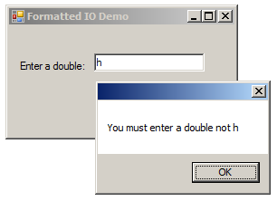
GUI User IO
Input via TextBox Control
  This code:
  … changes to:
try
{
myDouble = Convert::ToDouble(textBox1->Text);
}
catch (FormatException^)
{
MessageBox::Show("You must enter a double not " + textBox1->Text);
myDouble = 0;
}

Slide 33
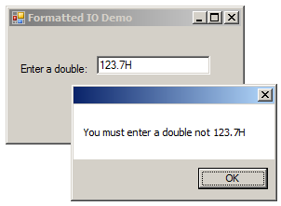
However……
Exceptions should really be the exception
  'try-catch' is resource-hungry and slows things down: on entering the try { } block a 'roll-back' log has to be kept to undo things if an exception was thrown.
  Better to use a method that returns 'false' if the conversion was not successful:
Best practice
double myDouble;
bool conversionOK;
if (textBox1->Text != "")
{
conversionOK = double::TryParse(textBox1->Text, myDouble);
if (!conversionOK)
{
MessageBox::Show("You must enter a double not " + textBox1->Text);
textBox1->Text=textBox1->Text->Remove(textBox1->Text->Length - 1); // remove last character
textBox1->SelectionStart = textBox1->Text->Length; // pace cursor at end of text
}
}

Slide 34
Summary
Formatted Input
  formatted C input functions bypass:
    canonicalisation, normalisation, sanitisation, validation
  this is not obvious to the programmer
  unformatted functions obviously leave this to the programmer
Formatted Output
  can be exploited by inserting format strings
GUI Input
  'try-catch' exception handling (should be the exception)
  basic validation with type::TryParse()

Slide 35
End of Lecture

